Slide 1
Harmonious learning spaces can make your instruction sing! Designing pedagogy-focused classroom and consultation areas
Emily Rimland
Kalin Librarian for Learning Innovations
Ellysa Stern Cahoy
Education & Behavioral Sciences Librarian
Penn State, University Libraries
University Park, PA
Notes:
Introduction, roadmap for today
Poll everywhere, later teamwork
4 themes today: sustainability, sense of place, capacity for change, pedagogical support
Interactive

Slide 2
What do you think?
Notes:
<?xml version="1.0" encoding="ISO-8859-1" ?>
<poll url="http://www.polleverywhere.com/multiple_choice_polls/Ue2hOZBxJLR6qtc">
<!-- This snippet was inserted via the Poll Everywhere Mac Presenter -->
<!-- The presence of this snippet is used to indicate that a poll will be shown during the slideshow -->
<!-- TIP: You can draw a solid, filled rectangle on your slide and the Mac Presenter will automatically display your poll in that area. -->
<!-- The Mac Presenter application must also be running and logged in for this to work. -->
<!-- To remove this, simply delete it from the notes yourself or use the Mac Presenter to remove it for you. -->
<title>What elements do you find most desirable for interactive learning spaces?</title>
</poll>

Slide 3
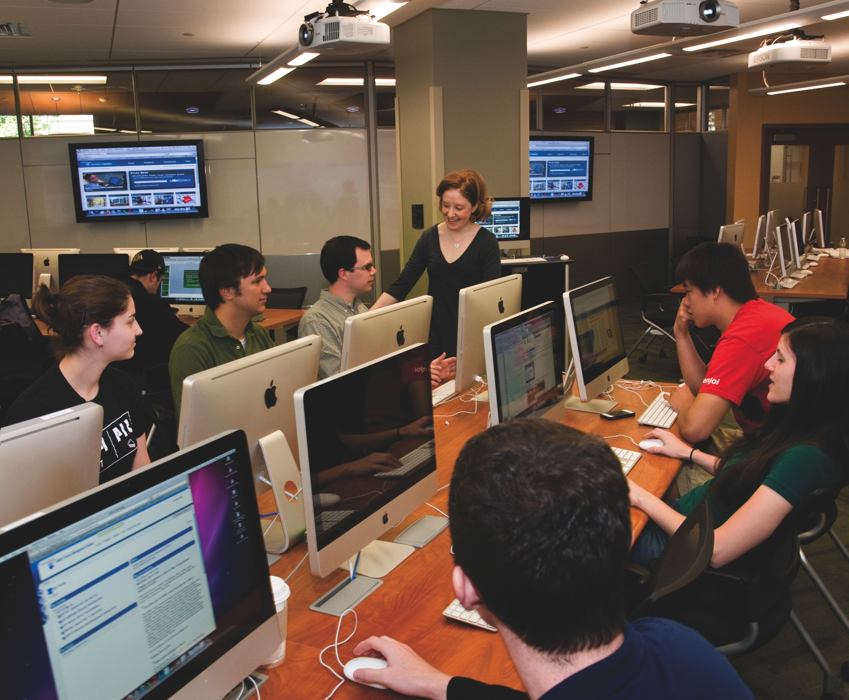
Overview of our experience
Notes:
In previous space, Closed Reserves was quickly declining, floor was sinking, need for group study rooms and a variety of group study spaces, media creation on the rise. Needed more class space.
Led to Fact finding, U of Delaware, Penn, Steelcase
Feasability study with architects
Research on library as place, information commons, mention others also provided input
This led to the concept of our Knowledge Commons, which is a re-envisioning of our first floor services and spaces. We’ll focus specifically on learning spaces here but will be important to mention some things other than just classrooms

Slide 4
Pedagogical problems
We asked ourselves….
What do we need most?
Notes:
KC opened in 2012. Prior to that t we had the opportunity to evaluate this space, so we also examined our pedagogical problems.
We knew we needed more space for classes, existing spaces were always booked. We also knew we needed one that was bigger (>25) for larger classes.
In general there was a lack of engagement and interaction between librarian and students in our other classrooms so that was a priority. We also wanted to build in spaces that would lend themselves to team-based activities where librarian and students could interact easily.
Space for research consultation since some ref desks were going away….capacity for change
Media creation process should be part of space, need expertise as well as equipment
Our problems became our solutions to fixing these issues in the new space.
Lots of overlap between themes

Slide 5
Pedagogical problem:
(lack of) Sustainability
Notes:
How we addressed these areas:
sustainability - green walls, ecofriendly, green, LEED CERTIFIED (goal, architects were LEED certified), recycled materials for items, provide connect from indoors to outdoors, energy, bottle filling station

Slide 6
Solution: Leed certified architect
Notes:
LEED certified, emphasis on reusability, sustainabiity
Leadership in energy and environmental design

Slide 7
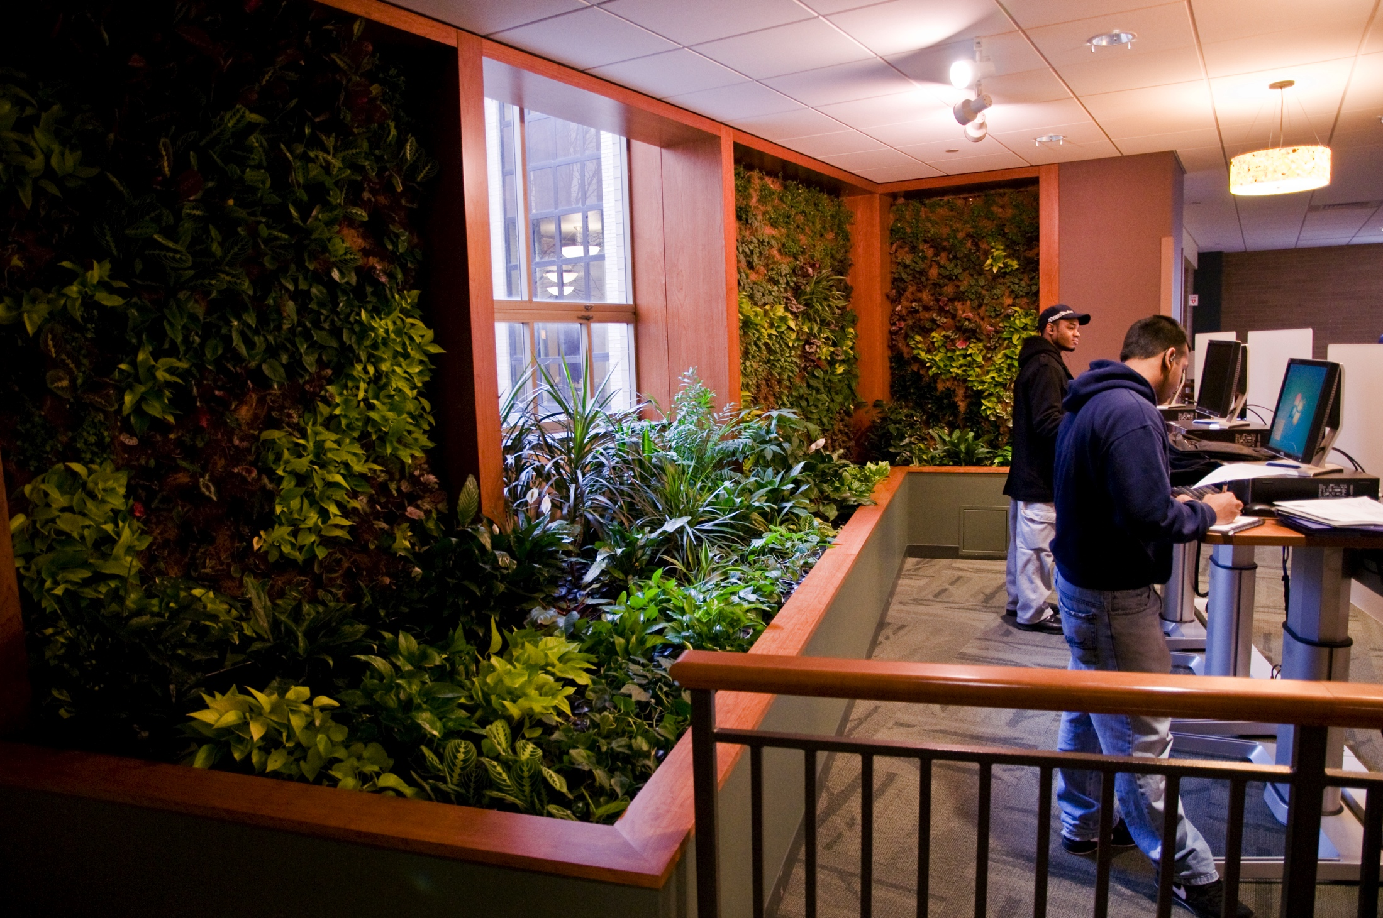
Solution: living walls

Slide 8
Solution: use natural lighting

Slide 9
Pedagogical problem:
(needed a)
Sense of Place
Notes:
How we addressed these areas:
sense of place - interior designer, colorful, glass walls--see students working; “no front” in W140media, Steelcase?

Slide 10
Solution: interior designer
Notes:
Interior designer helped to create “living room” spaces throughout – give it a more comfy feel, brought color to otherwise beige space, ability to see students working (see and be seen)

Slide 11
Solution: “no front” classroom
Notes:
Allows instructor to be more engaged, students more part of class, interaction between students, more flexible, supports team based learning

Slide 12
Solution: team-based spaces
Notes:
Librarian and student working closely together. Classroom and research consultations

Slide 13
Pedagogical problem
(lack of)
Capacity for change
Notes:
How we addressed these areas:
capacity for change - DRRT Walls, project on 4 walls/change configuration; Media::scape - USB plugin, don’t over-program the space

Slide 14
Solution: dirTt walls
Notes:
Customizable, pre-fab interior walls, reconfigurable and reused if needed
Do it right this time

Slide 15
Solution: configuration options
Notes:
Allow to easily form teams, can change projection configuration to fit a large or small classroom

Slide 16
Solution: flexibility
Notes:
Mediascapes allow connection by simple USB connection….for now works on most computers, allows more flexibiliy

Slide 17
Solution: don’t overprogram
Notes:
Adjustable desks to accommodate needs

Slide 18
Pedagogical problem:
(needed)
Pedagogical Support
Notes:
pedagogical support - shared classroom with MC; consultants (MC and ITS) are physically adjacent; needed Macs for media, worked with ITS to fund workstations

Slide 19
Solution: experts nearby

Slide 20
Solution: experts nearby

Slide 21
Solution: experts nearby

Slide 22
Solution: partnerships

Slide 23
Krause innovation studio
Notes:
New space in the college of education, where there is a laptop requirement
Teaching first, technology second
A BYOD (bring your own device) learning space and research facility, our mission is to assist faculty in transforming teaching and learning in higher education. Similar to library but aesthetic is different. Ecofriendly with lighting. Staffed, meant to be a faculty space where they consult about how to do stuff in class.
We focus on developing pedagogies that transform teaching and learning — by first identifying the kinds of interactions and activities students will engage in, then applying the best tools and resources to help educators reach them.

Slide 24
Krause classroom

Slide 25
What kinds of spaces does your library need most right now?

Slide 26
Your Turn!
Break into teams (groups of 5)
Each group gets a hypothetical scenario
Each person assigned a role, assume this role for the exercise
Each team needs a notetaker to record main points
Decisions your group makes
What are the greatest challenges your group faced?

Slide 27
Scenario #1
The coordinator for the basic freshman English course has contacted the library with the news that all students in the course will create a podcast and a video as part of their coursework each semester. This is a new addition to the course, and there is currently no technology on campus to support this initiative. Your group must draft a bullet list of goals for this project…

Slide 28
Scenario #2
Yes, it’s MOOC time! The distance education unit on campus has contacted the library indicating that they would like to create a space on campus where students can convene to listen to, reflect upon, and work on MOOCs. This is to be a collaborative space. It is your team’s job to decide how this request should be addressed, in the library or elsewhere.

Slide 29
Scenario #3
The Provost has a big idea: There will no longer be any general-use computers on campus, and every learning space will be BYOD (bring your own device). Your team is tasked with designing the Libraries’ new BYOD learning commons. Please note that your campus does NOT have a laptop requirement for students.

Slide 30
Scenario #4
Flip. That. Classroom! Your library is home to several (to be exact, two) outdated instructional spaces. Each room has 40 computers that are anchored to tables set in rows. The rooms are narrow, and students cannot move around and collaborate between (or even within) rows. A podium with a computer is at the front of the room. The rooms are so deep, that students in the back rows cannot see what is projected at the front. These rooms also double as general use computer labs for students when not in use. The Head of Reference and Instruction feels that the time has come to update the spaces. Your team is charged with recommending the needed changes in the rooms.

Slide 31
For further reading
Gibbon, Susan and Nancy Fried Foster. Studying Students: Undergraduate Research Project at the University of Rochester. Chapter Four: Library Design & Ethnography. ACRL, 2007.
Diana & James L. Oblinger. Educating the Net Generation. Chapter Twelve: Learning Spaces, Chapter Thirteen: Net-Generation Students & Libraries, Chapter fifteen: Planning for Neomillennial Learning Styles: Implications for Investments in Technology and Faculty. EDUCAUSE, 2005.
Commons 2.0: Library Spaces Designed for Collaborative Learning. Educause Quarterly, 2007.

Slide 32
Contact info
Emily Rimland
erimland@psu.edu
Ellysa Cahoy
ellysa@psu.edu
Web sites
PSU Knowledge Commons: http://www.libraries.psu.edu/psul/kc.html
Krause Innovation Studio: http://innovation.ed.psu.edu/

